Slide 1
OpenMP-Programming training-4
Chun-Yuan Lin

Slide 2
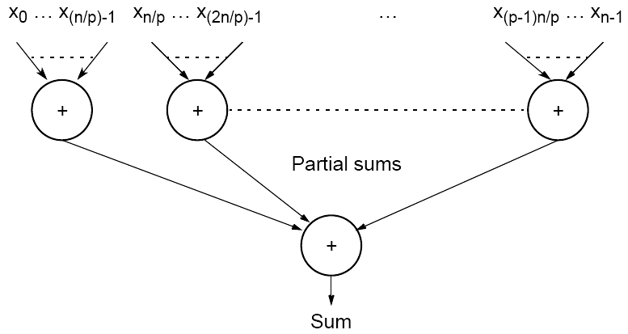
Partitioning a sequence of numbers into parts and adding the parts
For a simple master-slave approach, the numbers are sent from the master processor to the slave processors. They add their numbers, operating independently and concurrently, and send the partial sums to the master processor. The master processor adds the partial sums to form the result.

Slide 3
Training
Please declare an array with 100,000,000 elements, the value (range: 1-10) of each elements is randomly generated, and then write a OpenMP program to calculate the sum by using share memory programming. (1, 2, 4, 8, 16 processors)
  Calculate the speedup ratio for p=2, 4, 8, 16.

Slide 4
Please send the code of this training and the word file with the speedup ratio to my email. (before 5/7, 23:59).
  Please annotate your name and your student ID in email.
  The source code file name is “student ID”. If more than one source code files, the names are “student ID-1”, “student ID-2”, etc.
  Please compress the files to a .zip or .rar file. The file name is “student ID-train4”.
For example, a student has ID “A0000001” and two source code files. The source code file names are A0000001-1.c and A0000001-2.c and the compressed file name is A0000001-train4.zip.
The file will be rejected without following the rules.

